Slide 1
Lecture 1: CSE 220
Jannatun Noor
Jannatun.noor@bracu.ac.bd

Slide 2
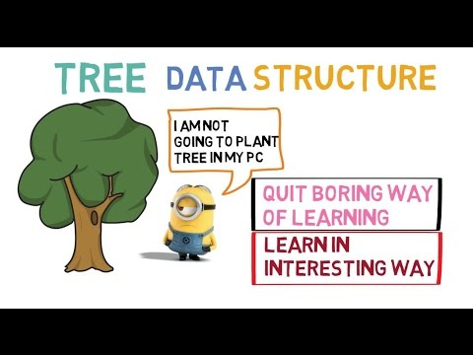
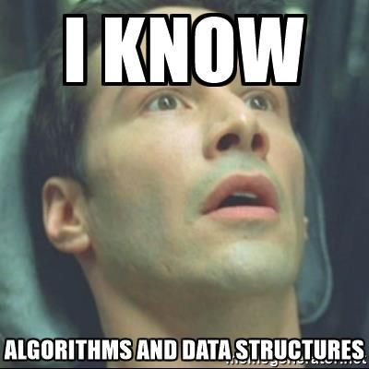

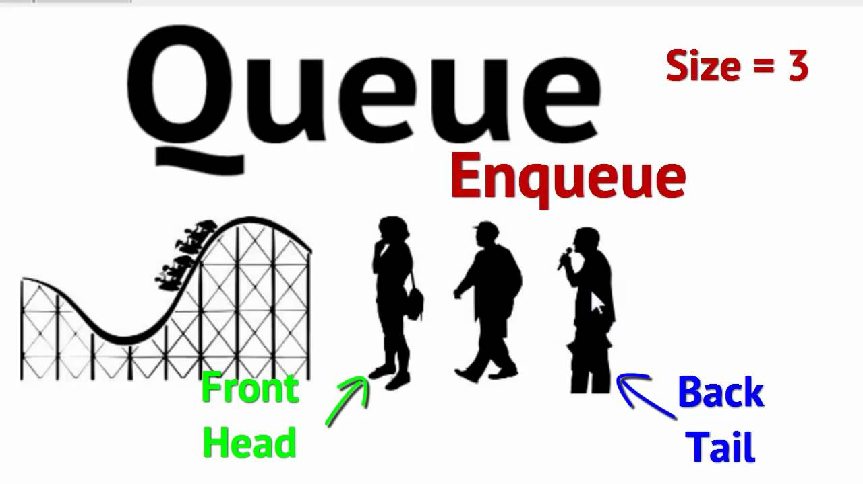

Slide 3
Java data types
Java primitives
char
String
Boolean
Numeric
Non-numeric
Byte
Int
…

Slide 4
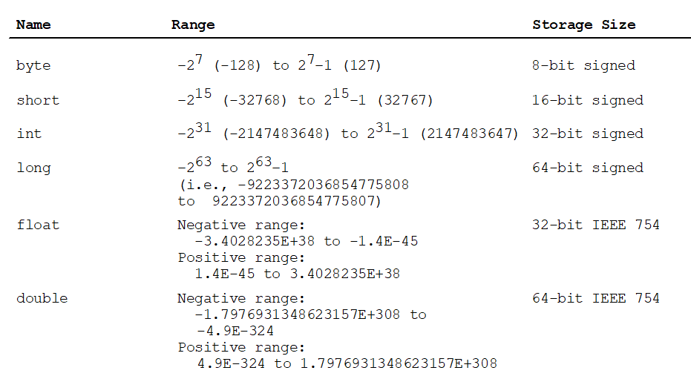
Java Numerical Primitives

Slide 5
Variables
public class Example1
{
public static void main ( String[] args )
{
int payAmount = 123;
System.out.println("The variable contains: " + payAmount );
}
}

Slide 6
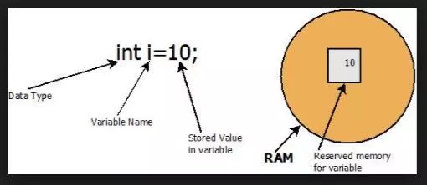
Variables in Java Memory

Slide 7
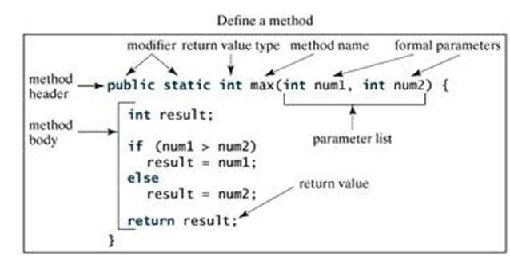
Methods

Slide 8
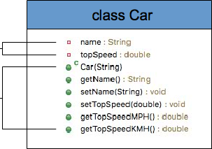
Class
variables
methods

Slide 9
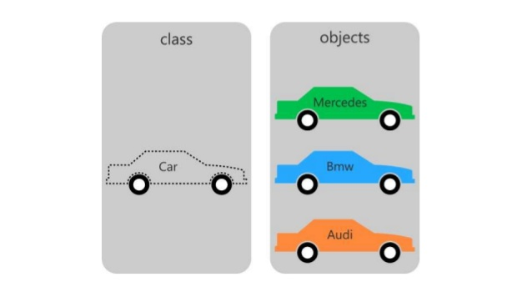
Objects

Slide 10
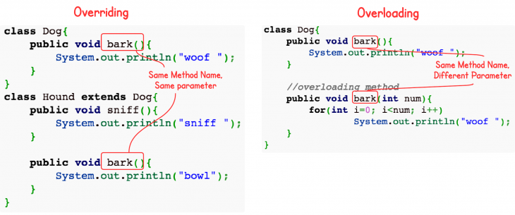
Overloading and Overriding

